Slide 1
Module 16
Marketing Strategies for Growing Markets
By: Dr Shahinaz Abdellatif

Slide 2
Objective of this session
1. To discuss the major strategic issues in growth markets

Slide 3
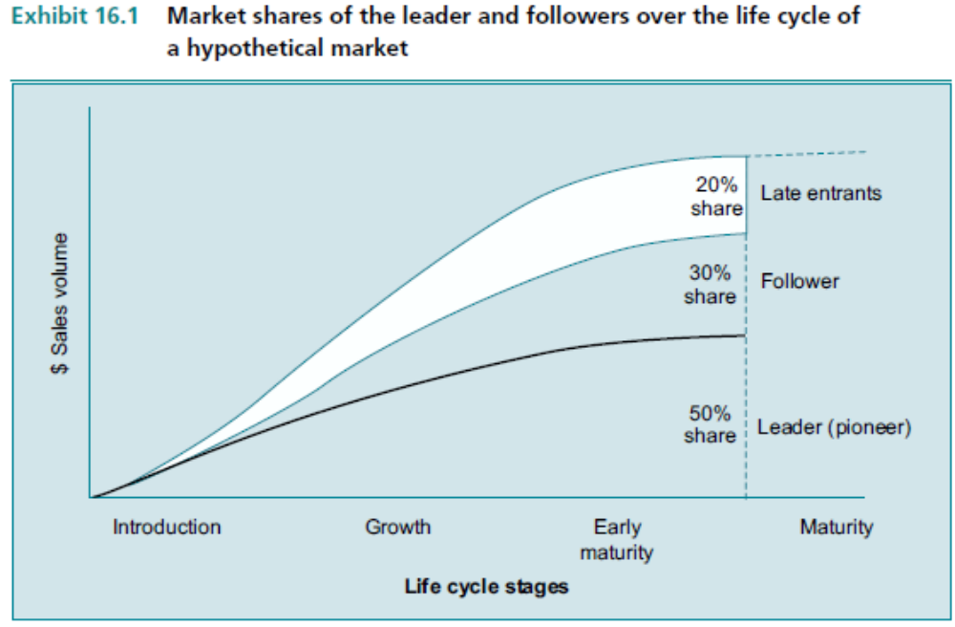
Market Shares of leaders & Followers

Slide 4
Growth Market Strategies for Market Leaders
Overall objective
  maintain leading share position in the face of competition as market expands
Marketing Objective
  retain existing customers
  e.g. - maintain/improve satisfaction and loyalty
  - encourage/simplify repeat purchase
  - reduce attractiveness of switching
  stimulate Selective demand among late adopters
  stimulate Primary demand to accelerate market growth

Slide 5
Strategic Choices for Share Leaders in Growth Markets
Flanker strategy - Proactive
Flanker strategy - Reactive
COMPETITOR OR POTENTIAL COMPETITOR
Fortress or position - defense
strategy
LEADER
Confrontation strategy - Proactive, Reactive
Contraction
or
Strategic
withdrawal
Market Expansion
Source: Adapted from P. Kotler and R. Singh, ‘Marketing Warfare in the 1980s’, Journal of Business Strategy, Winter 1981, pp. 30-41

Slide 6
Growth Market Strategies for Leaders
Fortress:- strengthen current position - beware of bypass attack.
Flanker:- develop a second “fighting” brand to compete with challenger.
Confrontation:- Protect against loss of share among current customers by meeting or beating a head-tohead competitive offering.

Slide 7
Growth Market Strategies for Leaders
Market expansion: Increase ability to attract new customers by developing new product offerings or line extensions aimed at a variety of new applications and user segments.
Contraction or strategic withdrawal: Increase ability to attract new customers in selected high-growth segments by focusing offerings and resources on those segments; withdraw from smaller or slower-growing segments to conserve resources.

Slide 8
Growth Strategies for Leaders
C:\Users\srashad\Desktop\Marketing Strategies for leaders.doc

Slide 9
Growth Market Strategies for Followers
Overall objective
  Attain market share growth
Marketing objective
  capture repeat/replacement purchases from customers of the leader/target competitor
  stimulate Selective demand from late adopters

Slide 10
Strategic Choices for Challengers in Growth Markets
Leapfrog Strategy
Flanking Attack
TARGET COMPETITOR
Frontal
Attack
CHALLENGER
Encirclement strategy
Source: Adapted from P. Kotler and R.Singh, ‘Marketing Warfare in the 1980s’. Reprinted with permission from Journal of Business Strategy, Winter 1981, pp. 30-41.

Slide 11
Strategies for Challengers
Frontal attack
  market homogeneous - price or identify opportunities for differentiation
Leapfrog attack (Bypass)
  differentiation, new generation of products
Flanking attack
  differentiation - concentrate 1 or 2 segments
Encirclement
  differentiation, target several segments simultaneously

Slide 12
Strategies for Challengers
C:\Users\srashad\Desktop\Marketing Strategies for challengers.doc

